Slide 1
Text Classification
RNN(Recurrent Neural Network), LSTM
2026 Fall
조상구교수

Slide 2
Contents
3. Model selection and evaluation
3.1. Cross-validation: evaluating estimator performance
3.1.1. Computing cross-validated metrics
3.1.2. Cross validation iterators
3.1.3. A note on shuffling
3.1.4. Cross validation and model selection
3.1.5. Permutation test score
3.2. Tuning the hyper-parameters of an estimator
3.2.1. Exhaustive Grid Search
3.2.2. Randomized Parameter Optimization
3.2.3. Searching for optimal parameters with successive halving
3.2.4. Tips for parameter search
3.2.5. Alternatives to brute force parameter search

Slide 3
Contents
3.3. Tuning the decision threshold for class prediction
3.3.1. Post-tuning the decision threshold
3.4. Metrics and scoring: quantifying the quality of predictions
3.4.1. Which scoring function should I use?
3.4.2. Scoring API overview
3.4.3. The scoring parameter: defining model evaluation rules
3.4.4. Classification metrics
3.4.5. Multilabel ranking metrics
3.4.6. Regression metrics
3.4.7. Clustering metrics
3.4.8. Dummy estimators
3.5. Validation curves: plotting scores to evaluate models
3.5.1. Validation curve
3.5.2. Learning curve

Slide 4
Cross-validation: evaluating estimator performance
Data Leakage의 개념에 대해 설명하고 과적합(Overfitting)과의 관계를 토론하고 이해하자
The knowledge about the test set can “leak” into the model and evaluation metrics no longer report on generalization performance. To solve this problem, yet another part of the dataset can be held out as a so-called “validation set”: training proceeds on the training set, after which evaluation is done on the validation set, and when the experiment seems to be successful, final evaluation can be done on the test set.

Slide 5

Cross-validation: evaluating estimator performance

Slide 6
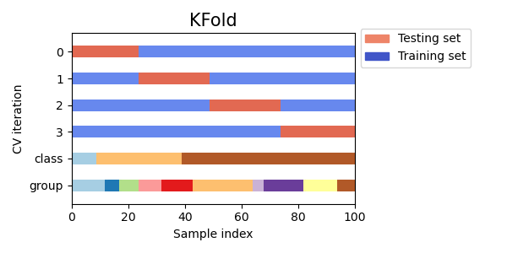
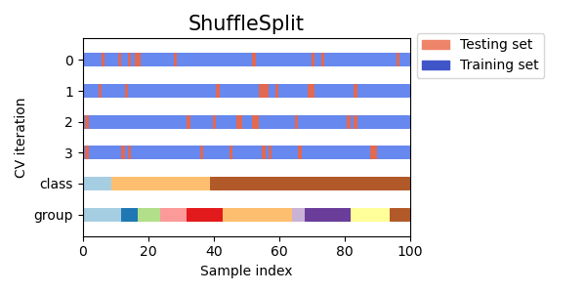
Cross-validation: evaluating estimator performance
cv 인자가 정수일 때, cross_val_score는 기본적으로 KFold 또는 StratifiedKFold(층화 K-폴드) 표본추출 방법을 사용하는 반해 ShuffleSplit 은 어떤 표본 추출 방법이고 장점은 무엇인가?
from sklearn.model_selection import cross_val_score
clf = svm.SVC(kernel='linear', C=1, random_state=42)
cross_val_score(clf, X, y, cv=5)
from sklearn.model_selection import ShuffleSplit
cv = ShuffleSplit(n_splits=5, test_size=0.3, random_state=0)
cross_val_score(clf, X, y, cv=cv)

